Slide 1
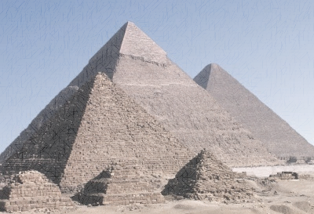
How can you find the volume of a pyramid?
Lets see if you can figure it out. Lets make Pyramids.
Cut around the edge of the pyramid shape.
Fold along the dotted lines.
Put glue on the tabs and form your pyramid.
Work with those around you to see if you can form another 3D object.

Slide 2
24
7
30
Date
Title
EQ –
5
Notes:
Lesson objective (EQ)

Slide 3
Lesson objective
By the end of this lesson you will be able to;
- Calculate the volume of spheres and pyramids
Notes:
Lesson

Slide 4
Success Criteria
You will know you are successful in achieving the objective by…
Being able to calculate the volume of spheres and pyramids

Slide 5
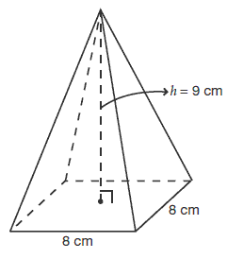
24
7
30
Date
Volume
EQ – How do you calculate the volume of a pyramid
Finding the volume of a pyramid
Find the volume of the prism based on the base shape eg. Volume = 8 x 8 x 9 = 576 cm³
Divide by 3 Pyramid Volume = 576/3 = 192cm³
5
Notes:
Input

Slide 6
24
7
30
Date
Volume
EQ – How do you calculate the volume of a sphere
Volume of a Sphere
V = 4/3𝝅r³
Why does this formula work https://www.youtube.com/watch?v=xuPl_8o_j7k
Mercury has a radius of 2,440km what is its volume
Volume of sphere – 3/4𝝅r³
Volume of Mercury = 3/4𝝅2440³
= 6.08496 x 10¹⁰
Half a sphere is called a hemisphere and the volume of a hemisphere is found by halving the volume of a sphere with a given radius.
5
Notes:
Input

Slide 7
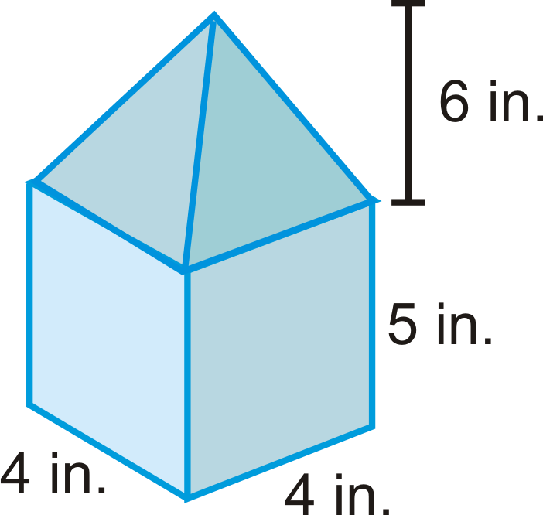
24
7
30
Date
Volume
EQ – How do you find the volume of composite shapes that contain spheres and pyramids.
How do you find
the volume of a
shape like this
one.
Break it into parts
Square prism and
Square pyramid
Find the volume of both then add the parts together.
Square prism = 4 x 4 x 5 = 80
Square pyramid = 1/3 (4 x 4 x 6) = 32
Total 80 + 32 = 112in³
5
Notes:
Input

Slide 8
Activity
Dwyer page 38 & 39
Nelson P119 – 18,19,20
Nelson pg 193 – 26 a & b; 28
Notes:
Independent practice

